Slide 1
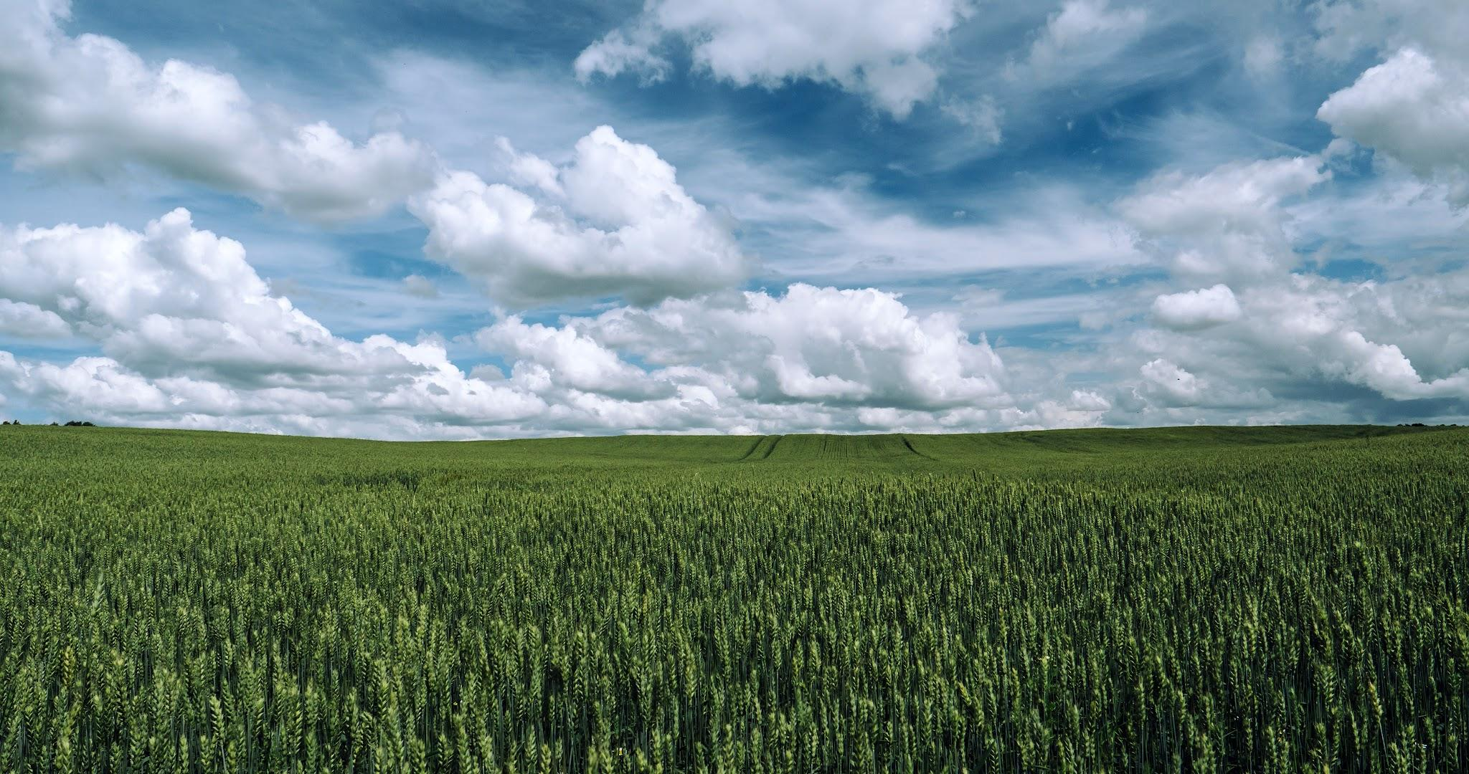

Smart Irrigation System for Sustainable Water Management using Regression Model
UNIVERSITY OF AGRICULTURAL SCIENCES ,COLLEGE OF AGRICULTURE,
GKVK, BANGLORE
Student group details
Deekshith.K.S.(AMB2052)
Nikhil Kumar.K.N(AMB2155)
Pavan.M. (AMB2167)

Slide 2
Content
Tools and Technologies Used
Results
Discussion / Analysis
Conclusion and Future Work
References/Acknowledgements
Introduction
Problem Statement
Motivation
Objectives of the project
Dataset Overview
Methodlogy/approach

Slide 3
Introduction
Agriculture is a major sector that depends heavily on water for crop production and sustainability.
Traditional irrigation methods are mostly manual and based on experience or fixed schedules.
These methods often lead to over-irrigation (water wastage) or under-irrigation
There is a growing need for efficient and sustainable irrigation systems to optimize water usage.

Slide 4
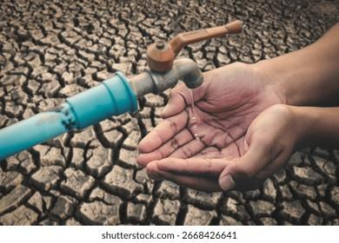
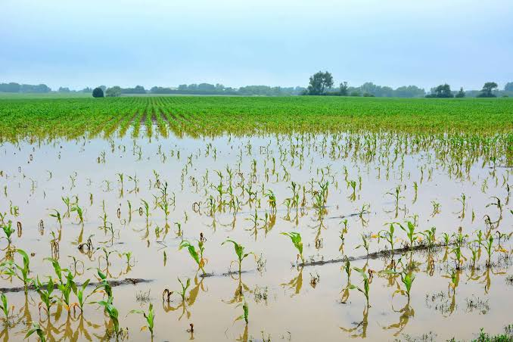
Farming Problem Area
Inefficient water usage is one of the biggest problems in agriculture.
Farmers often do not have accurate data to decide how much water is needed.
Soil conditions, temperature, humidity, and rainfall are not properly analyzed in traditional systems.

Slide 5
Problem Statement
Traditional irrigation systems are:
Manual and time-consuming
Based on guesswork
Often lead to over-irrigation or under-irrigation
Problem:- There is no accurate system to predict the exact water requirement for crops, leading to water wastage and reduced yield

Slide 6
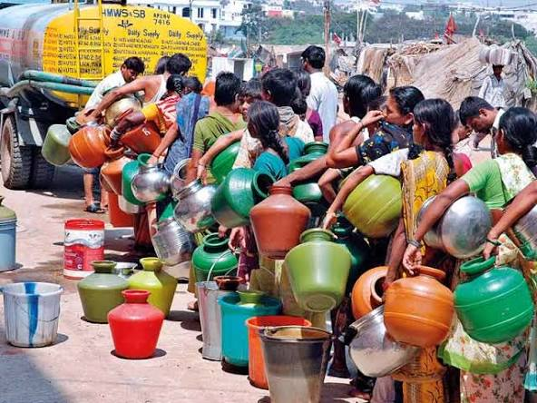
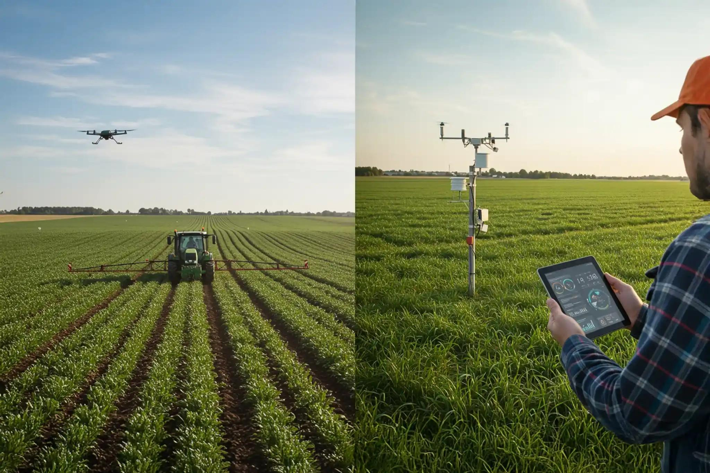
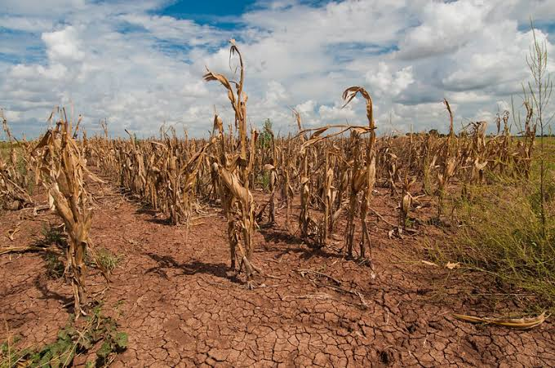
Motivation
Agriculture consumes over 70% of the world's freshwater
Data-driven methods help in making accurate and scientific farming decisions.

Slide 7
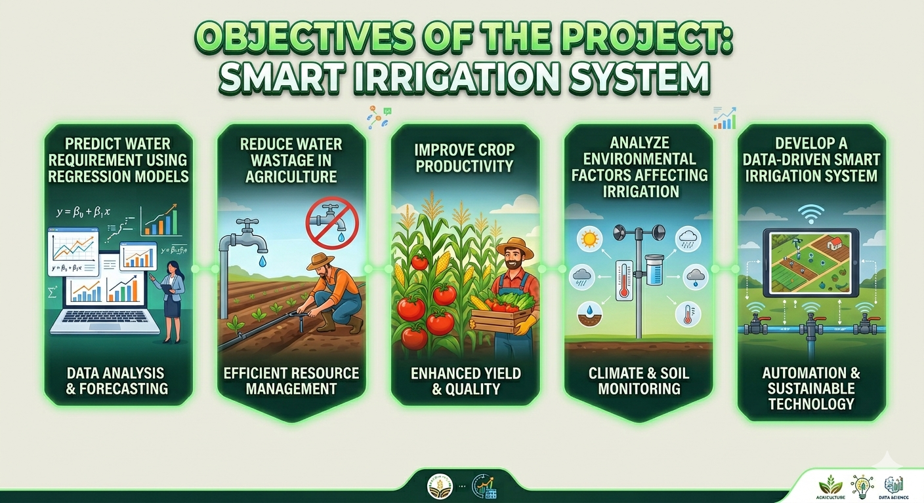
Objectives

Slide 8
Dataset Overview
The dataset includes environmental and soil parameters such as:
Soil Temperature
Humidity
Soil Moisture
Rainfall
Irrigation requirement (target variable)
Target output:
Water required (liters)

Slide 9
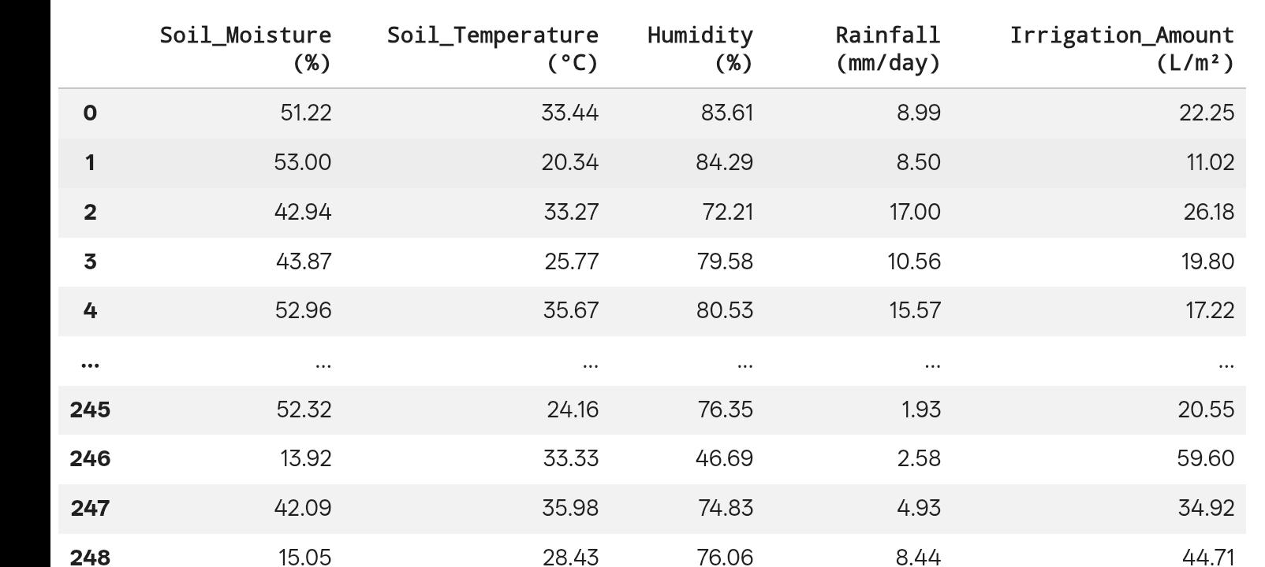
Dataset
Source:AICRP on Agrometrology

Slide 10
Methodology / Approach
Model Selection (Regression Models) │ ▼ Model Training │ ▼ Model Testing (MSE, RMSE, R²) │ ▼ Prediction of Irrigation │ ▼ Automatic Water Control │ ▼ End
Start │ ▼ Data Collection (Sensors/Dataset) │ ▼ Data Preprocessing (Cleaning, Normalization) │ ▼ Feature Selection │ ▼ Train-Test Splitting │ ▼

Slide 11


Tools and Technologies Used
Libraries Used:
Example - scikit-learn, pandas, numpy, matplotlib
Development Environment: Google Colab

Slide 12
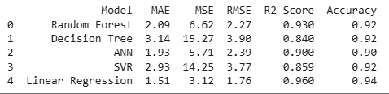
Results
Model performance metrics :-

Slide 13
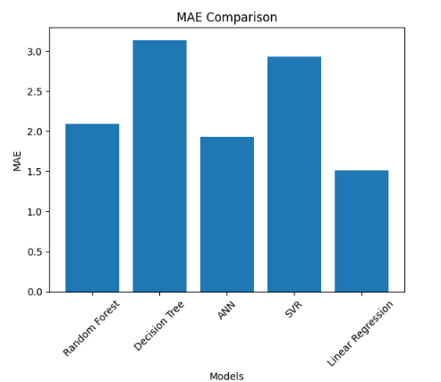
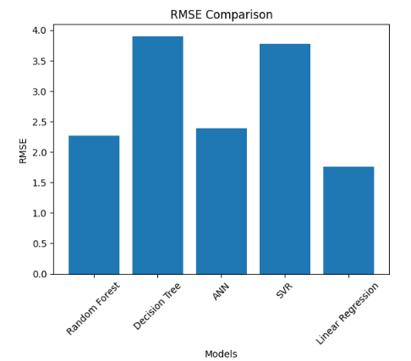
Visualizations:
MAE comparison of models
RSME comparison of models

Slide 14
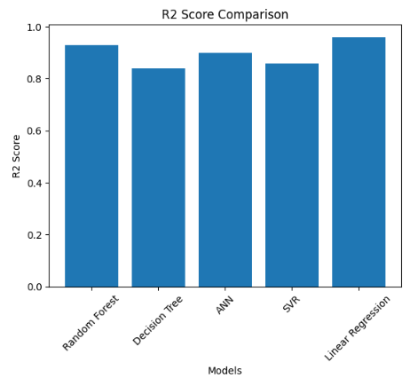
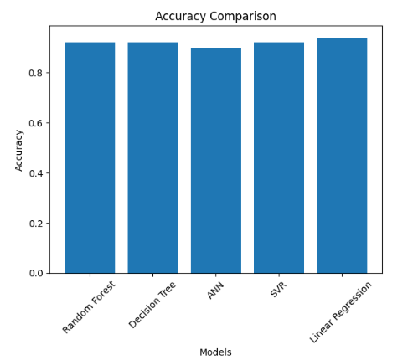
Accuracy comparison of models
3 R2 SCORE comparison of models

Slide 15
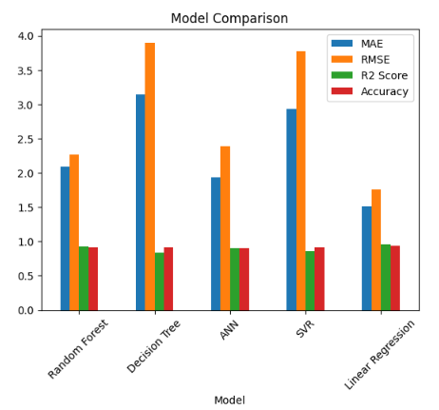
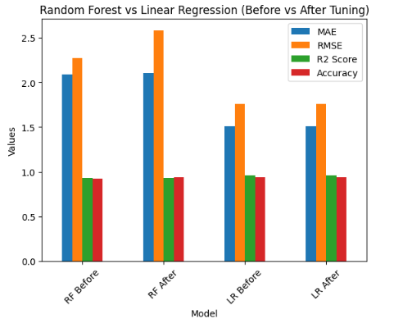
comparison of models after hypertuning
comparison of models

Slide 16
Observations:
The regression model successfully predicts water requirements.
Water usage reduced compared to traditional irrigation.
Improved crop health due to optimized watering.
Accuracy depends on quality and quantity of training data.

Slide 17
Discussion / Analysis
Linear Regression best: lowest errors, highest R² (0.960) and accuracy (0.94).
Random Forest good: strong performance, slightly below Linear Regression.
ANN moderate: needs more tuning/data.
Decision Tree & SVR weak: higher errors, less reliable.

Slide 18
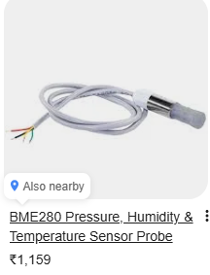
Limitations:
Requires reliable sensor data
Initial setup cost
Model accuracy depends on dataset quality
Internet dependency (if cloud-based)

Slide 19
How results could impact agricultural decision-making?
Improved irrigation planning (right amount of water)
Efficient water resource utilization
Reduced operational costs (energy, labor)
Enhanced crop yield and plant health
Simpler and reliable model selection (Linear Regression) Supports real-time, data-driven irrigation decisions

Slide 20
Future Scope
Integration with weather forecasting APIs
Use of advanced ML models (Random Forest, Neural Networks)
Mobile app for monitoring
Solar-powered irrigation system

Slide 21
Practical Application
Smart irrigation scheduling using predicted water requirements
Integration with sensors (soil moisture, temperature) for automated systems
Use in precision agriculture for field-specific irrigation
Mobile/web-based decision support tools for farmers
Optimization of water use in drip and sprinkler systems
Support for sustainable farming and resource management

Slide 22
Conclusion
Data-driven system optimizes irrigation using soil and environmental parameters
Accurately predicts water requirements, reducing wastage and improving yield
Linear Regression performed best, indicating a strong linear relationship
Enables automation with minimal human intervention and real-time decisions
Cost-effective solution supporting sustainable and efficient agriculture

Slide 23
References
Ahansal, Y., Bouziani, M., Yaagoubi, R., Sebari, I., & Kenny, L. (2022). Towards Smart Irrigation: A Literature Review on the Use of Geospatial Technologies and Machine Learning. Journal: Agronomy, 12(2), 297.
Tace, Y., Tabaa, M., El Filali, S., & Cherkaoui, L. (2022). Smart Irrigation System Based on IoT and Machine Learning. Journal: Energy Reports.
Roy, U. B. P., Sattar, K. N. A., & Elngar, A. A. (2025). A Smart Irrigation System Using IoT and Advanced Machine Learning Model. Journal: Journal of Smart Internet of Things.
Abiadi, Y., Elamrani Abou Elassad, Z., El Meslouhi, O., & Ed-dahbi, A. M. (2023). Application of Machine Learning Techniques for Smart Irrigation Systems: A Systematic Review. Journal: SSRN / Smart Agricultural Technology.
Jaiswal, N., Kumar, T. V., & Shukla, C. (2025). Smart Drip Irrigation Systems Using IoT: Review of Architectures and Machine Learning Models. Journal: Discover Agriculture (Springer).

Slide 24


